Slide 1
Capstone Engagement
Assessment, Analysis, and Hardening of a Vulnerable System

Slide 2
Table of Contents
This document contains the following sections:
01
Network Topology
02
Red Team: Security Assessment
03
Blue Team: Log Analysis and Attack Characterization
Hardening: Proposed Alarms and Mitigation Strategies
04

Slide 3
Network Topology
‹#›

Slide 4
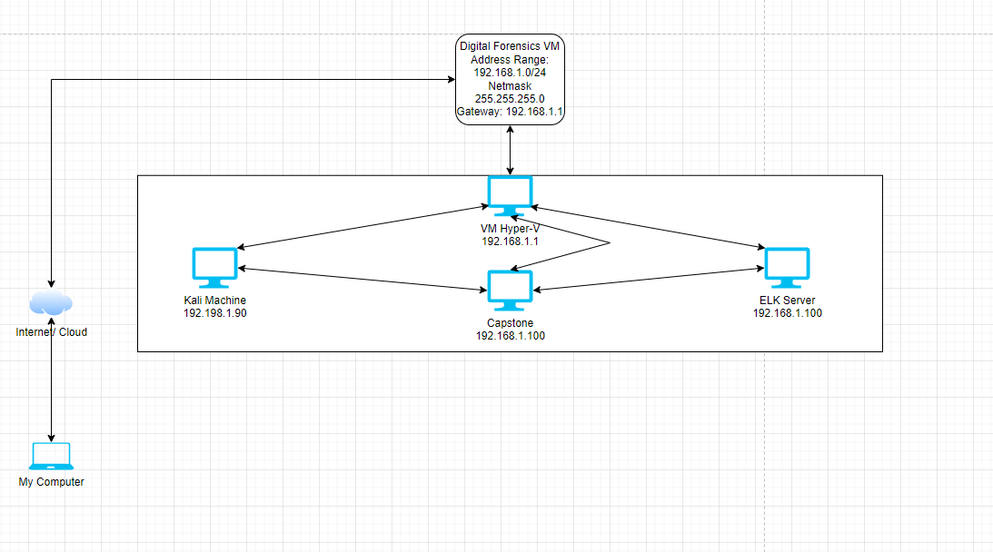
Network Topology
Network
Address Range: 192.168.1.0/24
Netmask: 255.255.255.0
Gateway: 192.168.1.1
Machines
IPv4: 192.168.1.90
OS: Linux
Hostname: Kali
IPv4: 192.168.1.105
OS: Ubuntu
Hostname: Capstone
IPv4:192.168.1.100
OS: Ubuntu
Hostname: ELK server
IPv4: 192.168.1.1
OS: Windows
Hostname: Hyper-V

Slide 5

Red Team
Security Assessment
‹#›

Slide 6
Recon: Describing the Target
Nmap identified the following hosts on the network:
Hostname | IP Address | Role on Network
Hyper-V | 192.168.1.1 | Virtual Machine Manager.
Capstone | 192.168.1.100 | Forwards logs to the ELK server. Used to test alerts.
ELK | 192.168.1.105 | Holds Kibana dashboards.
Kali | 192.168.1.90 | Attacking machine.

Slide 7
Vulnerability Assessment
The assessment uncovered the following critical vulnerabilities in the target:
Vulnerability | Description | Impact
Port Scan | Scanning ports to see what ports are open and closed. It can also detect service/version types. | Allows the attacker to gather information on open ports. 22 and 9200
Webdav and hidden directory | These directories had password hashes that gave the attacker access into the webdav to make changes. | An LFI vulnerability allows attackers to gain access to sensitive credentials
Brute force | Uses trial-and-error to guess login info, encryption keys, or find hidden web pages. | Allowed attack to guess login info to gain access to device.
Reverse shell | Attacker was able to upload a malicious php file to the website. | Outbound connection was detected and eventually gave the attacker root access to the device.

Slide 8
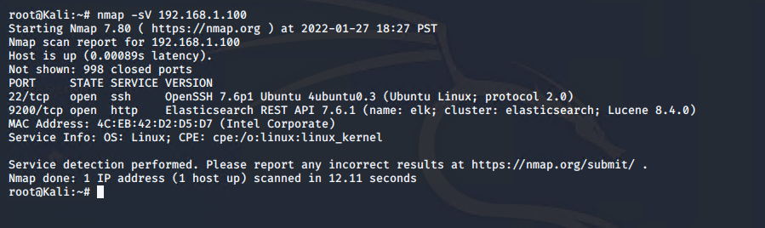
Exploitation: Port Scan
01
02
Tools & Processes
Which tool or techniques did you use?
Nmap
Arguments –s and -V
Achievements
I found out that ports 22 and 9200 were open, and what service/version was running.

Slide 9
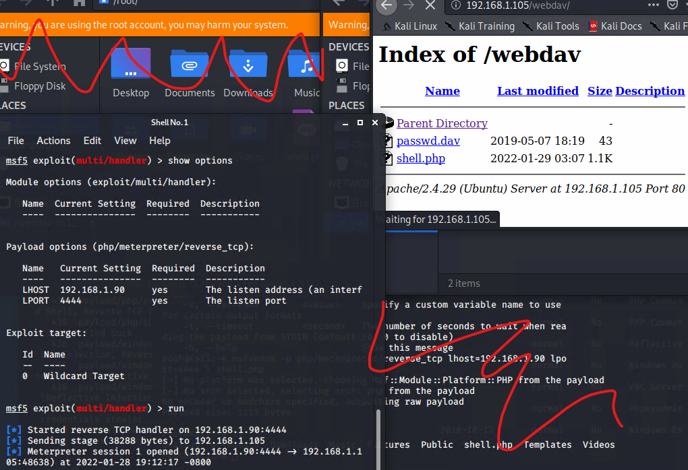
Exploitation: Unauthorized File Upload through Webdav
Achievements
Using Webdav I was able to crack a found password. This access allows me to upload a .php file.
01
02
Tools & Processes
Accessed Webdav to get the password hash.
Crackstation.net was used to crack hash.
After cracking hash, I gained access to webdav to upload malicious file.
03

Slide 10
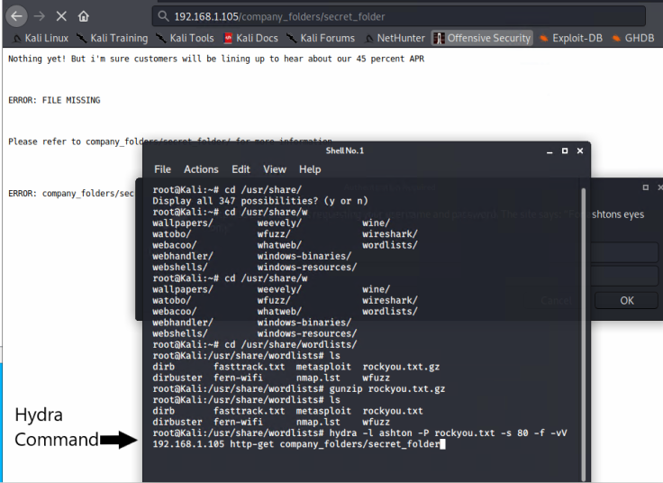
Exploitation: Brute Force Attack
01
03
Tools & Processes
I used hydra to brute force into the target machine.
02
Achievements
Using the rockyou.txt wordlist in hydra, I started a brute force login of ashton’s account.

Slide 11

Blue Team
Log Analysis and Attack Characterization
‹#›

Slide 12

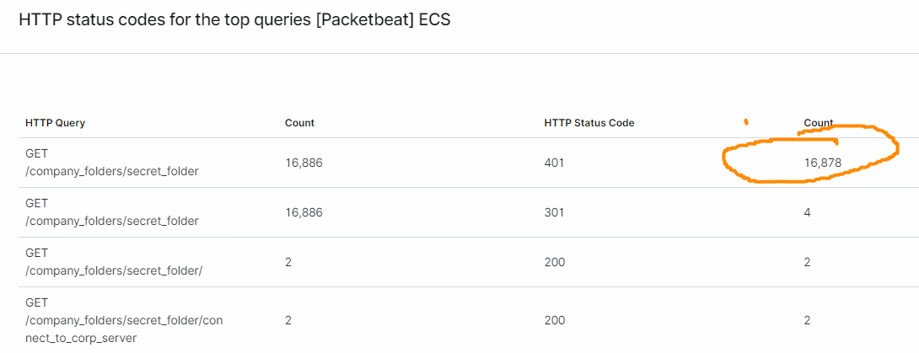
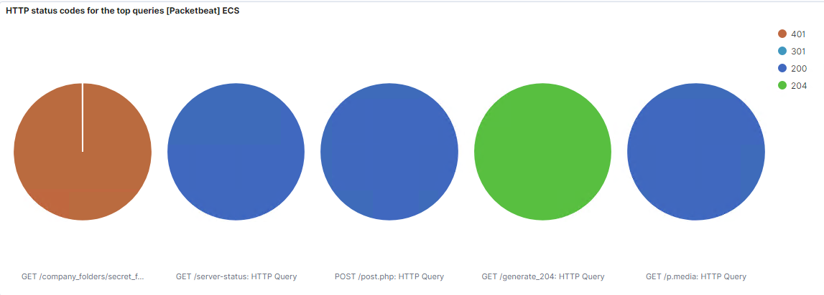
Analysis: Identifying the Port Scan
What time did the port scan occur? 18:27 on 1/27/2022
What indicates that this was a port scan? The amount of requests, in numerical order.

Slide 13
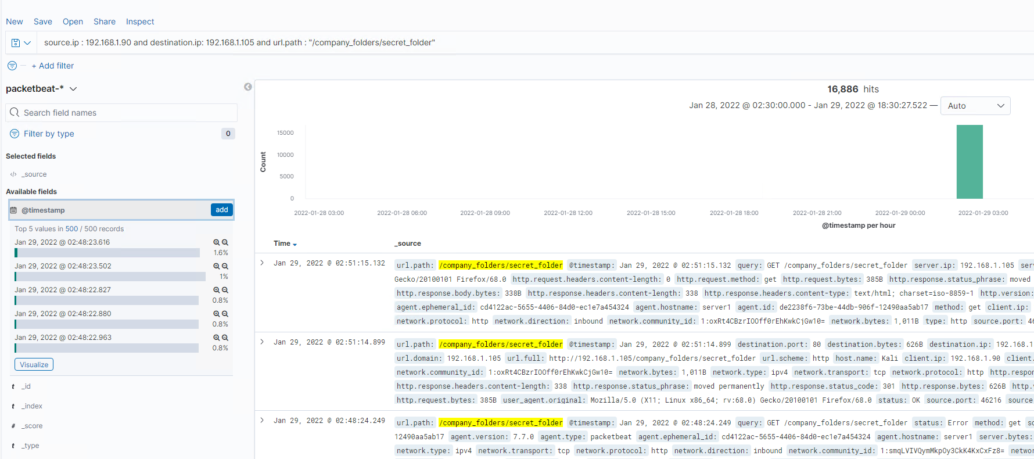
Analysis: Finding the Request for the Hidden Directory
What time did the request occur? 01/29/2022 @ 02:48
How many requests were made? 16886 requests
Which files were requested? The company secret folder
What did they contain? Employee information leading to device being compromised.

Slide 14
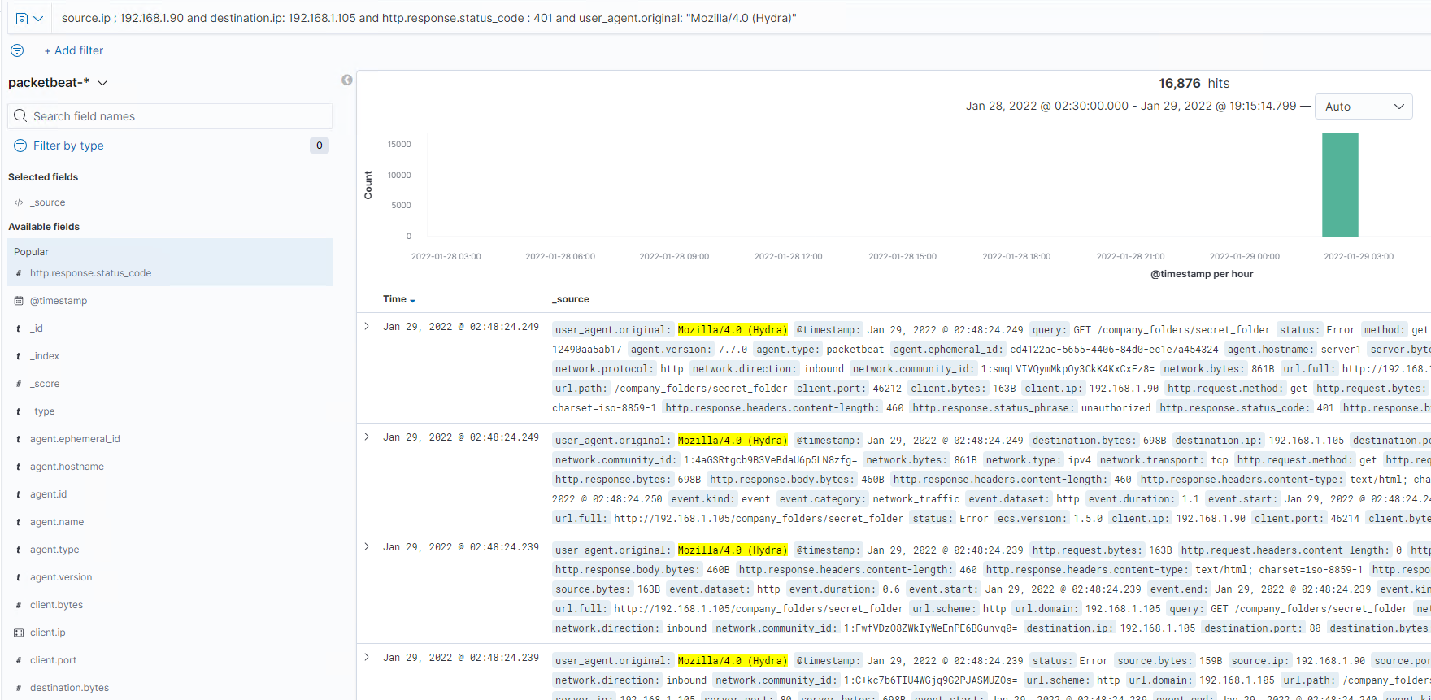
Analysis: Uncovering the Brute Force Attack
How many requests were made in the attack? 16876 hits
How many requests had been made before the attacker discovered the password? 16875 attempts
[Insert Here]
Include a screenshot of Kibana logs depicting the brute force attack.

Slide 15
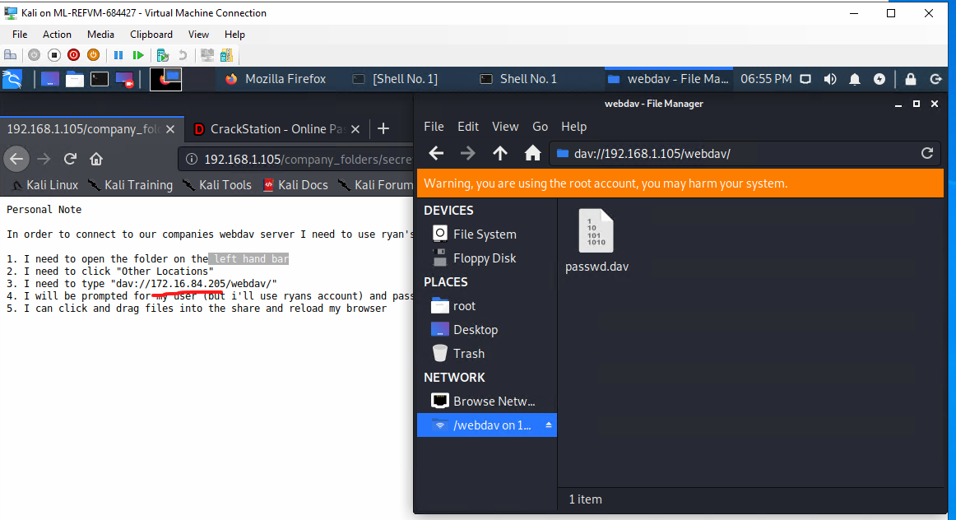
Analysis: Finding the WebDAV Connection
How many requests were made to this directory? 2
Which files were requested? Secret File from Company_folder
[Insert Here]
Add a screenshot of Kibana logs depicting the WebDAV connection.

Slide 16
Blue Team
Proposed Alarms and Mitigation Strategies
‹#›

Slide 17
Mitigation: Blocking the Port Scan
What kind of alarm can be set to detect future port scans?
Alarm could be set to detect incremental port connections.
What threshold would you set to activate this alarm?
Within 30 seconds, or large number of attempts.
What configurations can be set on the host to mitigate port scans?
Disable ICMP within the firewall
Describe the solution. If possible, provide required command lines.
Use firewalld to disable ICMP within the public zone.

Slide 18
Mitigation: Finding the Request for the Hidden Directory
What kind of alarm can be set to detect future unauthorized access?
Whitelist who can have access. Secure the directory behind password and 2FA
What threshold would you set to activate this alarm?
Any access from non-whitelist IP
What configuration can be set on the host to block unwanted access?
Block all unauthorized outside access.
Describe the solution. If possible, provide required command lines.
Remove public data from website

Slide 19
Mitigation: Preventing Brute Force Attacks
What kind of alarm can be set to detect future brute force attacks?
After so many number of incorrect login attempts.
What threshold would you set to activate this alarm?
Block after 10 attempts Then lockout for progressively more time. Force 2FA after lockout.
What configuration can be set on the host to block brute force attacks?
Block attempts to access network after so many tries.
Describe the solution. If possible, provide the required command line(s).
Blocking the user agents or byte count as another blocking option.

Slide 20
Mitigation: Detecting the WebDAV Connection
What kind of alarm can be set to detect future access to this directory?
Alert anytime someone accesses the Webdav directory.
What threshold would you set to activate this alarm?
Any access at all.
What configuration can be set on the host to control access?
Whitelist Ips to specific developers who need the access to make changes to the website.
Describe the solution. If possible, provide the required command line(s).
Block all access except for the few who need access.

Slide 21
Mitigation: Identifying Reverse Shell Uploads
What kind of alarm can be set to detect future file uploads?
An alarm for any file that is uploaded to Webdav.
What threshold would you set to activate this alarm?
1. No files should be edited from this folder.
What configuration can be set on the host to block file uploads?
Secure all important files into a vault. Restrict file uploads to the server.
Describe the solution. If possible, provide the required command line.
Another solution is to disable all file uploads to the website/server

